Slide 1
Quick Look: Variance Reduction at Scale
Improving IMC methods for thermal transport problems via a response function approach
Scott Campbell
Gonzaga University
Physics & Math-Computer Science

Slide 2
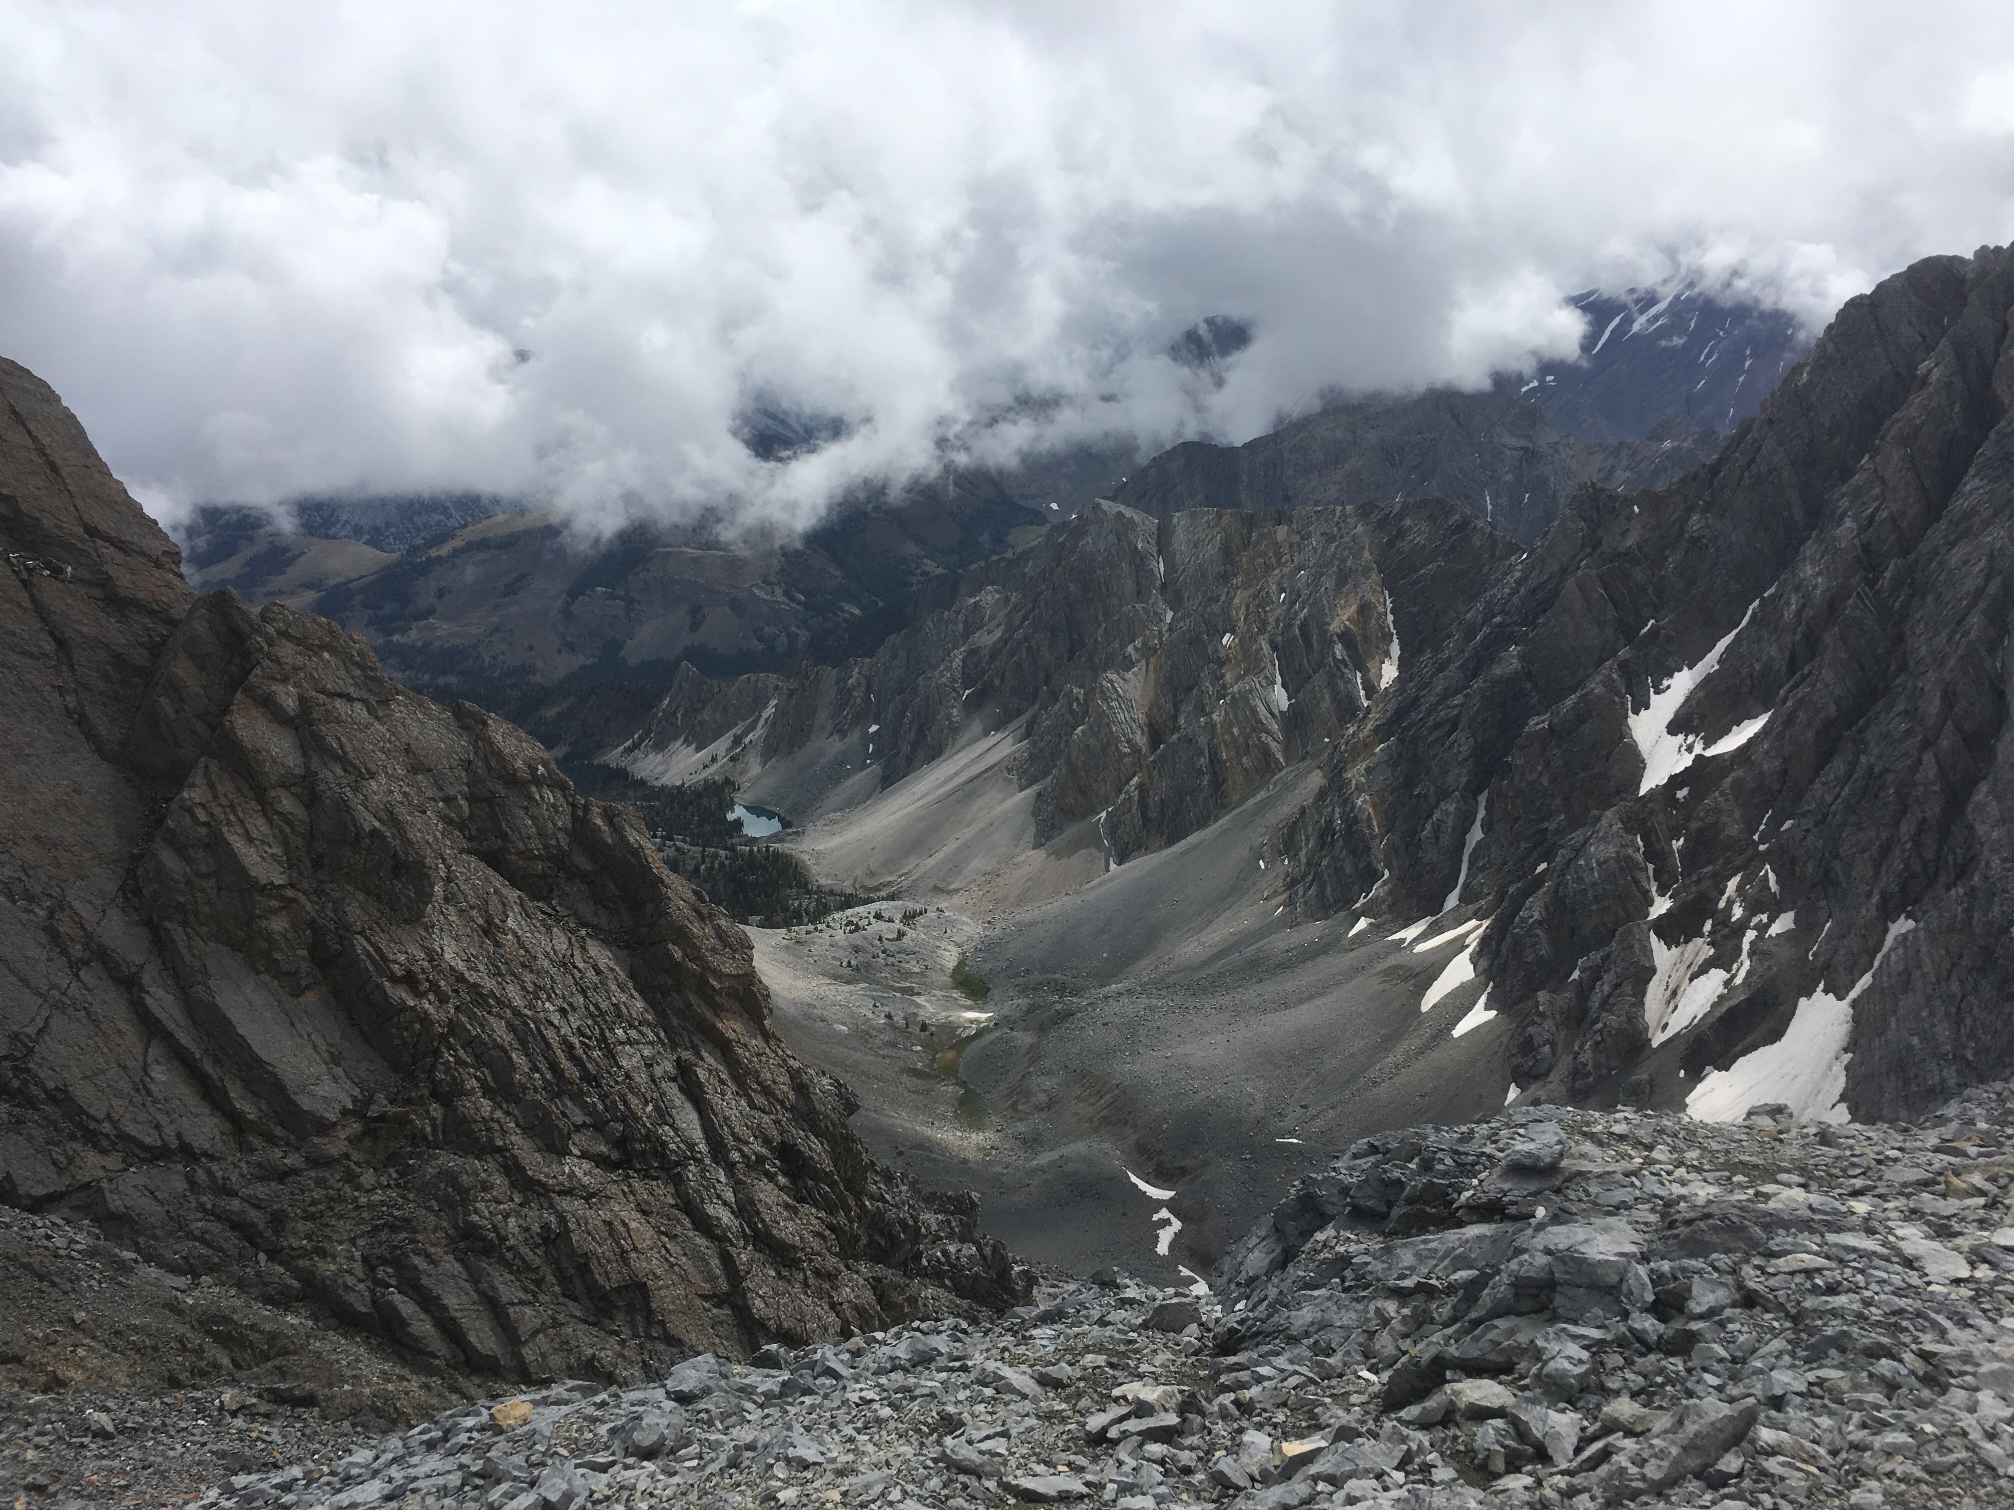
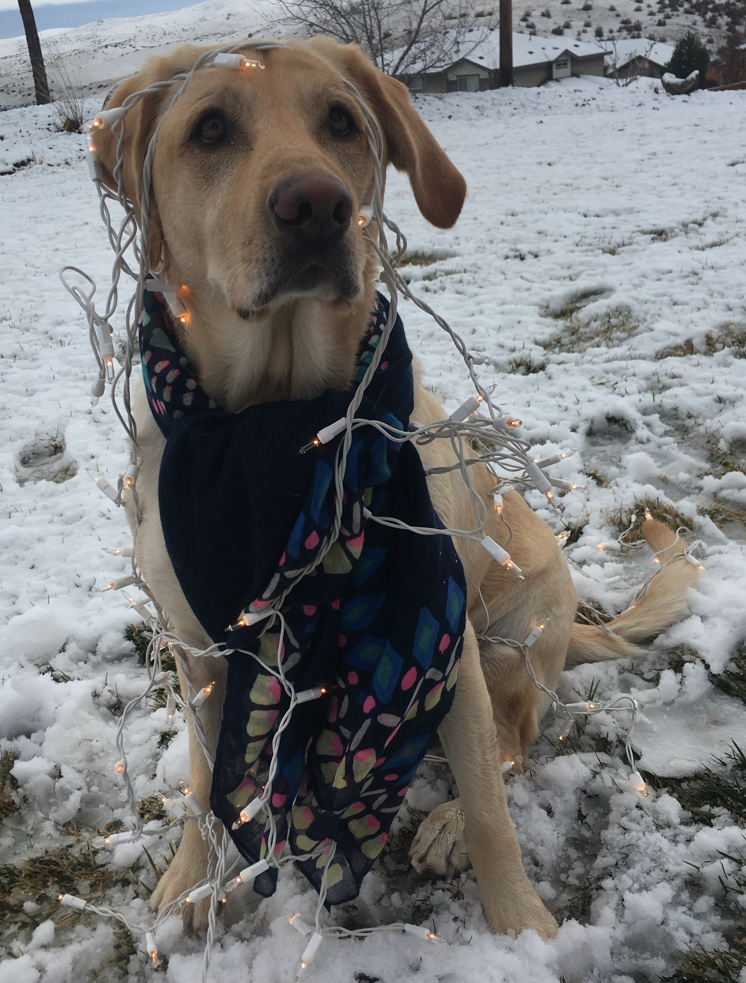
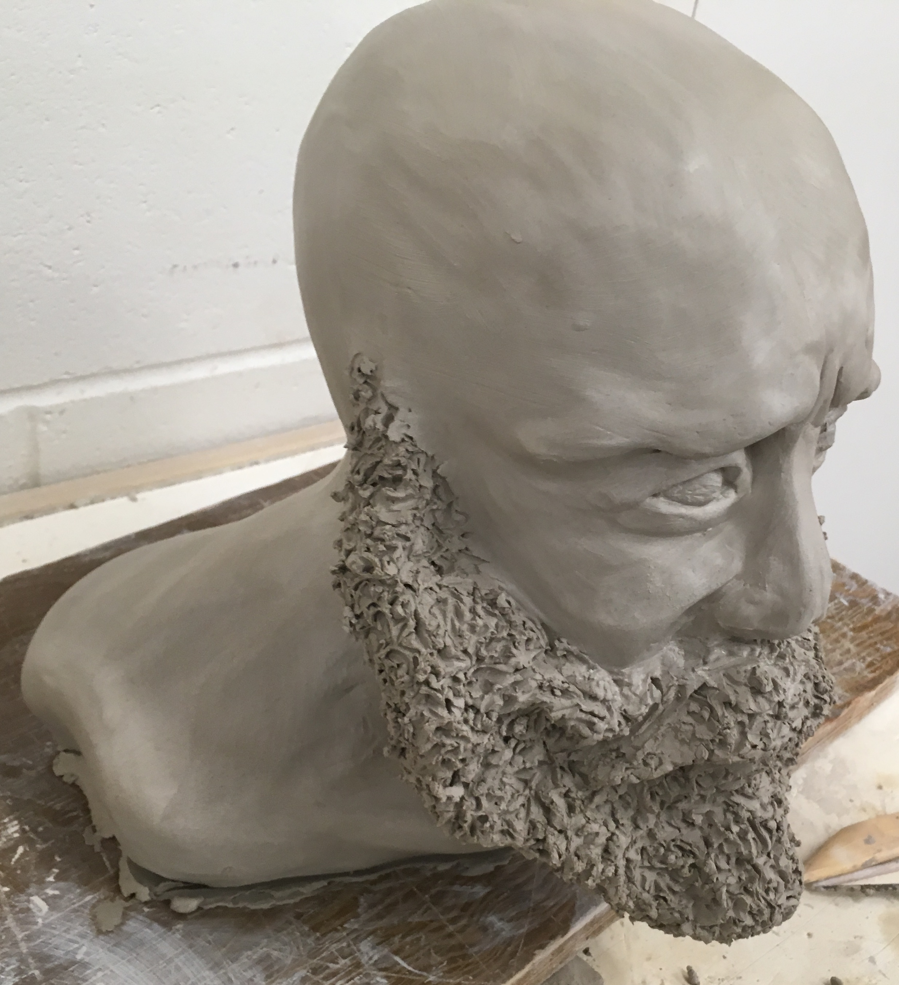
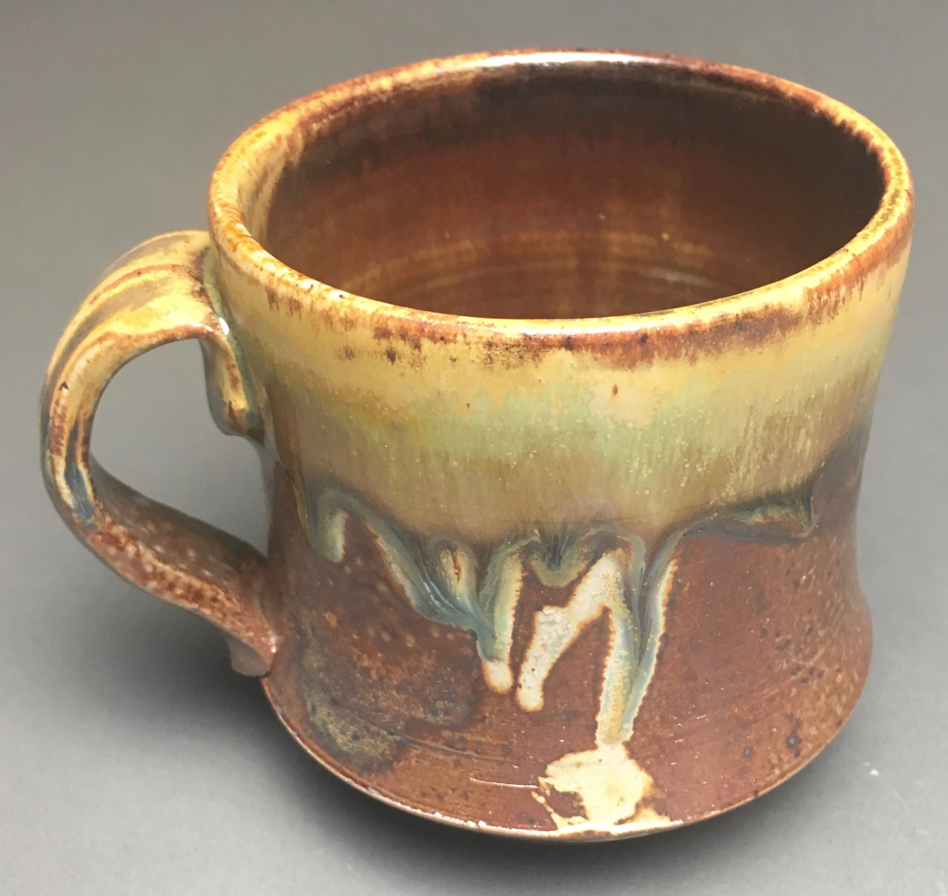
Background & Interests
Education, Work, and Research
Gonzaga Univ., Spokane WA
Physics & Math-Computer Science
Consultant for GroGuru Inc.
Established an async. RS-485 serial communication protocol variant for two indep. μCs via near field magnetic induction antennae
GSRP 2018 Summer Intern
Designed a cosmic ray muon detector advancing upon the MIT Cosmic Watch project
Capable of particle energy approx. and air-shower coincidence detection
AJP publication in review
Electrical Impedance Tomography
Cont. Fall 2019; Numerical Methods for PDE approx. for medical imaging technologies
My History and Interests

Slide 3
Overview of Response Function Approach

